Slide 1
Zener Regulators
PEE
FE CSBS
NMIMS Navi Mumbai

Slide 2
Outline
Introduction
Voltage Regulation
Line Regulation
Load Regulation

Slide 3
Introduction
Batteries are often shown on a schematic diagram as the source of DC voltage but usually the actual DC voltage source is a power supply.
There are many types of power supply. Most are designed to convert high voltage AC mains electricity to a suitable low voltage supply for electronics circuits and other devices.
A more reliable method of obtaining DC power is to transform, rectify, filter and regulate an AC line voltage.
A power supply can by broken down into a series of blocks, each of which performs a particular function.

Slide 4
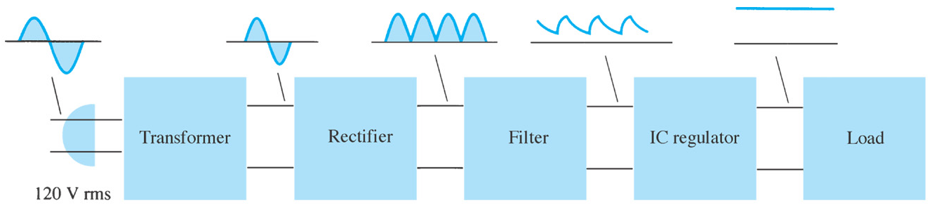
Introduction
Power supply: a group of circuits that convert the standard ac voltage (230 V, 50 Hz) provided by the wall outlet to constant dc voltage
Transformer : a device that step up or step down the ac voltage provided by the wall outlet to a desired amplitude through the action of a magnetic field

Slide 5
Introduction
Rectifier: a diode circuits that converts the ac input voltage to a pulsating dc voltage
The pulsating dc voltage is only suitable to be used as a battery charger, but not good enough to be used as a dc power supply in a radio, stereo system, computer and so on.

Slide 6
Introduction
There are two basic types of rectifier circuits:
  Half-wave rectifier
  Full-wave rectifier - Center-tapped & Bridge full-wave rectifier
In summary, a full-wave rectified signal has less ripple than a half-wave rectified signal and is thus better to apply to a filter.

Slide 7
Introduction
Filter: a circuit used to reduce the fluctuation in the rectified output voltage or ripple. This provides a steadier dc voltage.
Regulator: a circuit used to produces a constant dc output voltage by reducing the ripple to negligible amount. One part of power supply.

Slide 8

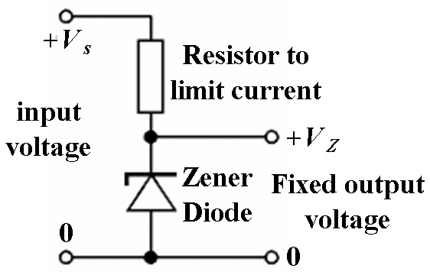
Introduction
Regulator - Zener diode regulator
For low current power supplies - a simple voltage regulator can be made with a resistor and a zener diode connected in reverse.
Zener diodes are rated by their breakdown voltage V_{z} and maximum power P_{z} (typically 400mW or 1.3W)

Slide 9
Voltage Regulation
Two basic categories of voltage regulation are:
  line regulation
  load regulation
The purpose of line regulation is to maintain a nearly constant output voltage when the input voltage varies.
The purpose of load regulation is to maintain a nearly constant output voltage when the load varies

Slide 10
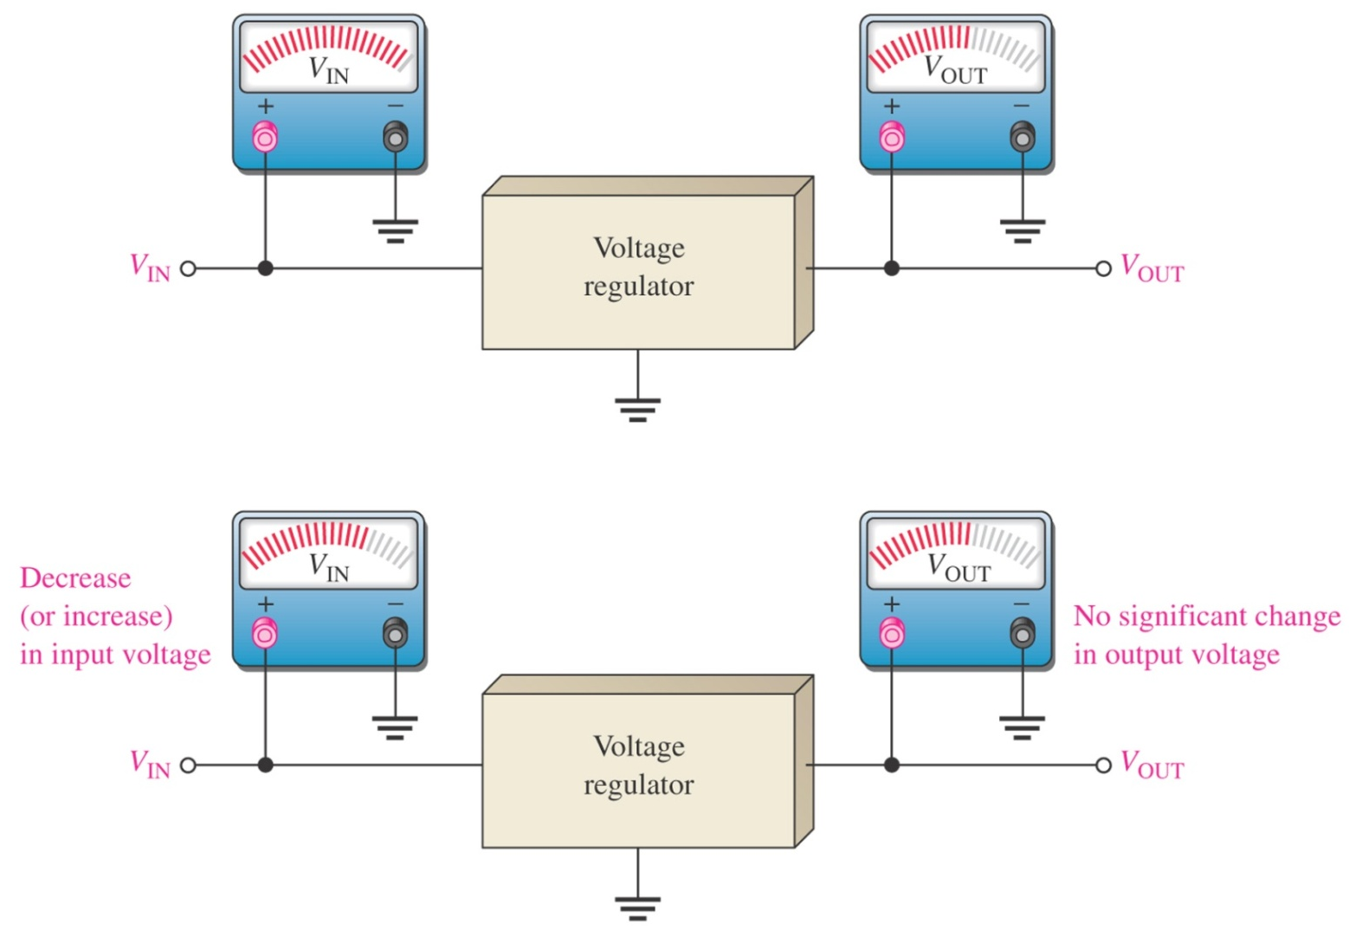
Line Regulation
Line regulation: A change in input (line) voltage does not significantly affect the output voltage of a regulator (within certain limits)

Slide 11
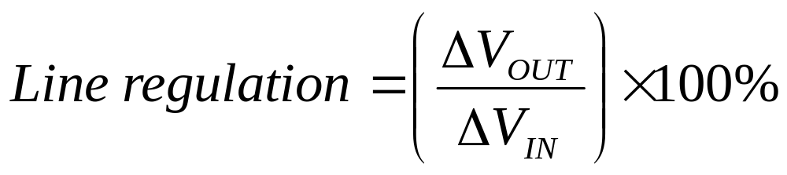
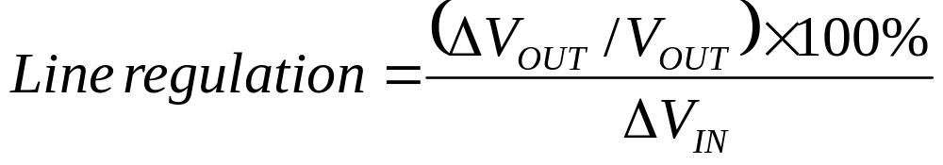
Line Regulation
Line regulation can be defined as the percentage change in the output voltage for a given change in the input voltage.
Δ means “a change in”
Line regulation can be calculated using the following formula:

Slide 12
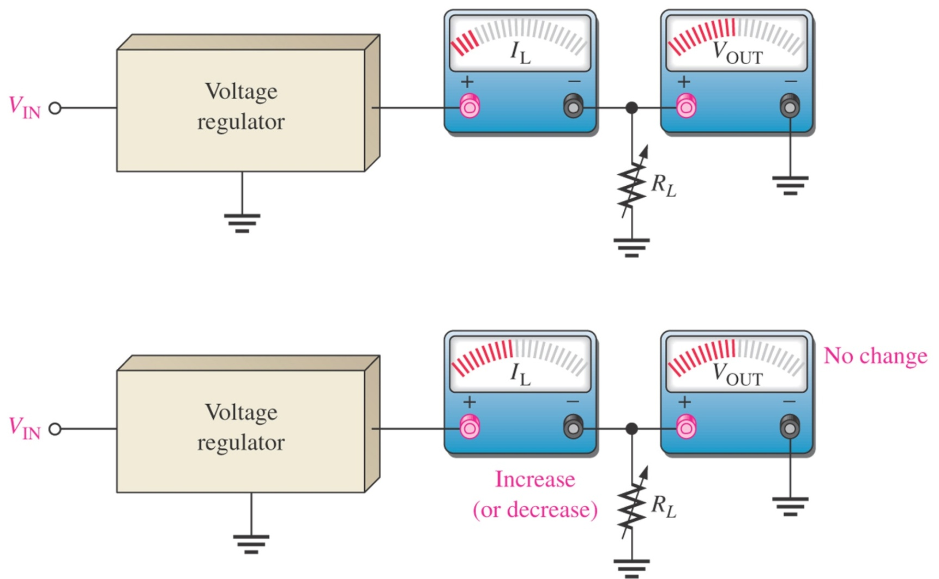
Load Regulation
Load regulation: A change in load current (due to a varying R_{L}) has practically no effect on the output voltage of a regulator (within certain limits)

Slide 13
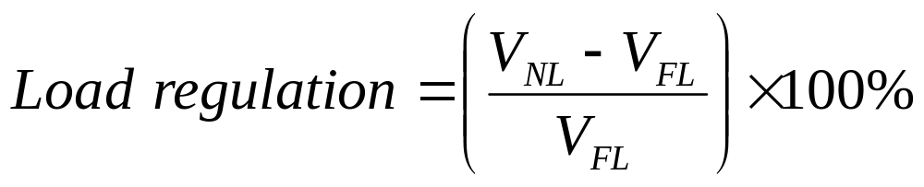
Load Regulation
Load regulation can be defined as the percentage change in the output voltage from no-load (NL) to full-load (FL).
Where:
V_{NL} = the no-load output voltage
V_{FL} = the full-load output voltage

Slide 14
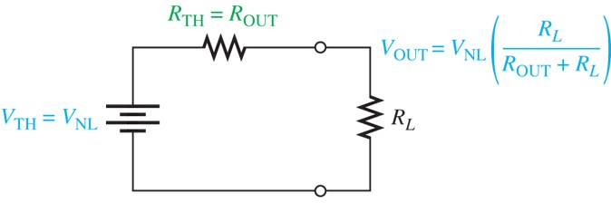
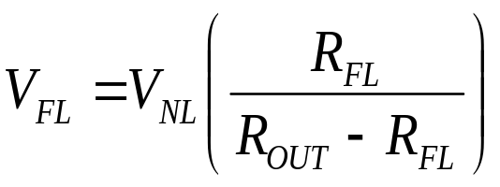
Load Regulation
Sometimes power supply manufacturers specify the equivalent output resistance (R_{out}) instead of its load regulation.
R_{FL} equal the smallest-rated load resistance, then V_{FL}:

Slide 15
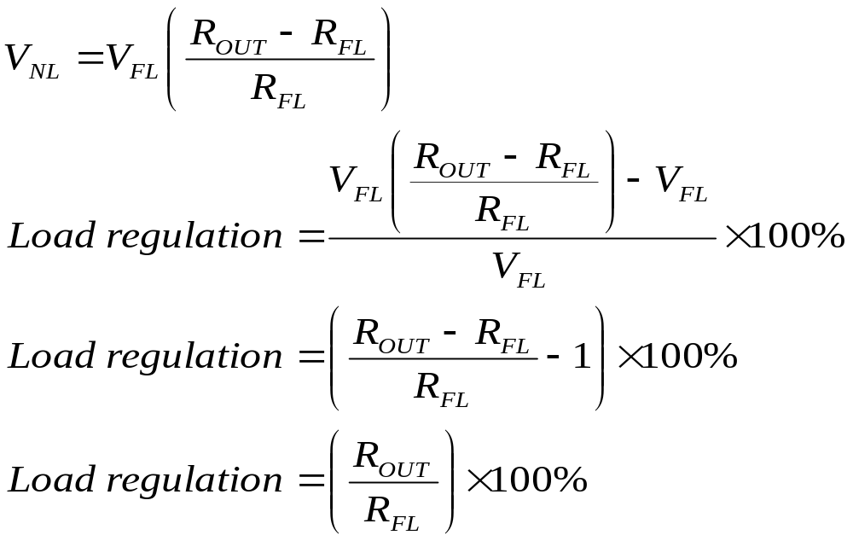
Load Regulation
Rearrange the equation:

Slide 16
Example
The input of a certain regulator increases by 3.5 V. As a result, the output voltage increases by 0.042 V. The nominal output is 20 V. Determine the line regulation in both % and in %/V.
(Solution: 1.2% ; 0.06%/V)
If a 5 V power supply has an output resistance of 80 mΩ and a specific maximum output current of 1 A. Calculate the load regulation in % and %/mA.
(Solution: 1.6% ; 0.0016%/mA)

Slide 17
Numericals
A 5.0V stabilised power supply is required to be produced from a 12V DC power supply input source. The maximum power rating P_{Z} of the zener diode is 2W. Using the zener regulator circuit above calculate:
a). The maximum current flowing through the zener diode.
b). The minimum value of the series resistor, R_{S}
c). The load current I_{L} if a load resistor of 1kΩ is connected across the zener diode.
d). The zener current I_{Z} at full load.

Slide 18
Numericals
A 5.0V stabilised power supply is required to be produced from a 12V DC power supply input source. The maximum power rating P_{Z} of the zener diode is 2W. Using the zener regulator circuit above calculate:
a). The maximum current flowing through the zener diode.400mA
b). The minimum value of the series resistor, R_{s} 17.5 ohms
c). The load current I_{L} if a load resistor of 1kΩ is connected across the zener diode. 5mA
d). The zener current I_{Z} at full load. 395mA

Slide 19
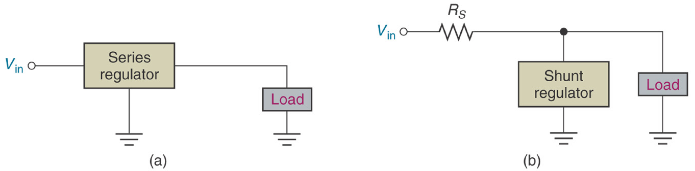
Types of Regulator
Fundamental classes of voltage regulators are linear regulators and switching regulators.
Two basic types of linear regulator are the series regulator and the shunt regulator .
The series regulator is connected in series with the load and the shunt regulator is connected in parallel with the load.

